Slide 1

kjjbfsdh
AUDIO CLASSIFIER
Presented By :
BHUVANESH M
613521104303
CSE-3rd YEAR

Slide 2
AGENDA
Introduction
Problem statement
Project overview
Who are the end user?
Your solution and its value proposition
The wow in your solution
Modeling
Result

Slide 3
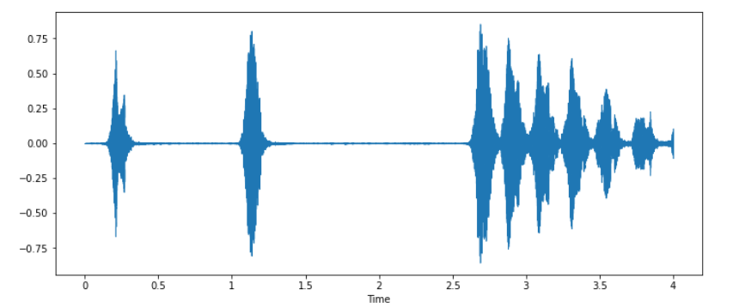
Introductions
Briefly introduce the topic of audio classification and its importance in various applications.
Mention the goal and objectives of your project.
Discuss the importance of audio classification in various domains such as speech recognition, music genre classification, environmental sound analysis, etc.

Slide 4
PROBLEM STATEMENT
Objective:
Develop an accurate and efficient deep learning-based audio classifier to categorize audio signals into predefined classes.
Scope:
Collect diverse audio dataset (speech, music, environmental sounds).
Preprocess data for model training (spectrograms, MFCCs).
Design deep learning models (CNNs, RNNs) for classification.
Train and evaluate models using metrics like accuracy, precision, recall.
Optimize models for improved performance and deploy for real-time classification.

Slide 5
PROBLEM STATEMENT
Requirements:
Proficiency in Python, TensorFlow/PyTorch for model development.
Knowledge of audio signal processing and deep learning architectures.
Experience in data preprocessing, model training, and evaluation.
Ability to optimize models and deploy for practical usage.
Deliverables:
Trained deep learning models with documentation.
Preprocessed dataset and codebase.
Presentation summarizing project overview, methodology, results, and deployment.

Slide 6
PROJECT OVERVIEW
Approach:
Data Collection: Gather diverse audio samples covering different categories (e.g., speech, music, environmental sounds).
Data Preprocessing: Convert audio data into suitable formats (e.g., spectrograms, MFCCs) for model training.
Model Development: Design and implement deep learning models such as CNNs or RNNs for audio classification.
Model Training: Train the models using labeled data and optimize hyperparameters for performance.

Slide 7
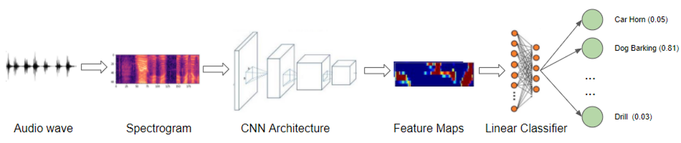
PROJECT OVERVIEW
5. Model Evaluation: Evaluate model performance using metrics like accuracy, precision, recall, and F1 score.
6. Optimization: Fine-tune models and explore techniques like data augmentation for improved accuracy.
7. Deployment: Deploy the trained model for real-time audio classification or batch processing.

Slide 8
WHO ARE THE END USER?
General Consumers: Users of music streaming platforms and voice assistants benefit from accurate audio categorization for personalized recommendations and voice commands.
Content Creators: Musicians and podcasters use the classifier for automatic tagging and organization of their content, improving workflow efficiency.
Healthcare Professionals: Medical practitioners utilize the classifier for analyzing and categorizing medical sounds, aiding in diagnosis and patient monitoring.

Slide 9
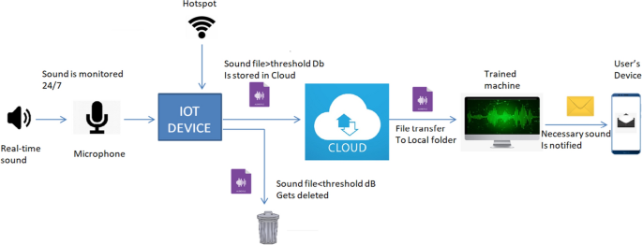
WHO ARE THE END USER?
Security and Surveillance:
Security personnel rely on the classifier to detect specific sounds like alarms or gunshots in surveillance systems for prompt response.
Environmental Monitoring:
Organizations use the classifier for analyzing environmental sounds, aiding in wildlife conservation and pollution monitoring.

Slide 10
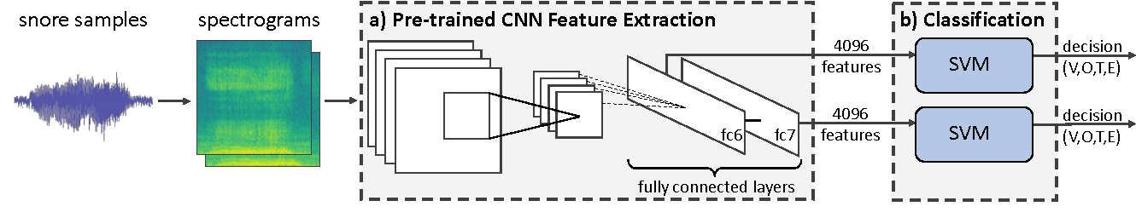
YOUR SOLUTION AND ITS VALUE PROPOSITION
Our deep learning-based audio classifier accurately categorizes audio signals like speech, music, and environmental sounds.
The core value of our audio classifier lies in its accurate classification, real-time processing, versatile applications, efficiency, and scalability, providing enhanced productivity and decision-making capabilities.

Slide 11
THE WOW IN YOUR SOLUTION
Precision and Speed: Our audio classifier achieves industry-leading accuracy levels while processing audio signals in real-time, enabling instantaneous categorization and decision-making.
Versatility: Capable of handling various types of audio data, including speech, music, and environmental sounds, our classifier adapts seamlessly to different applications and scenarios.
Efficiency and Automation: By automating the audio classification process, our solution reduces manual effort and streamlines workflows, leading to increased productivity and resource optimization.

Slide 12
THE WOW IN YOUR SOLUTION
Scalability: Designed to scale effortlessly, our classifier can handle large volumes of audio data without compromising on performance or accuracy, ensuring reliability even in high-demand environments.
User-Friendly Interface: With an intuitive and user-friendly interface, our solution makes it easy for users to interact with and utilize the classifier effectively, enhancing overall user experience and satisfaction.
Continuous Innovation: Committed to ongoing innovation and improvement, we continuously update and enhance our classifier to incorporate the latest advancements in deep learning technology, ensuring that it remains at the forefront of audio processing capabilities.

Slide 13
Modeling
Data Preprocessing:
Convert audio data into spectrograms or MFCCs for model input.
Normalize data to improve training efficiency.
2. Model Architecture Design:
Design CNNs, RNNs, or hybrid models for audio classification.
Optimize network depth, layer types, and activation functions.
3. Model Training:
Split data into training, validation, and test sets.
Train model, monitor performance, prevent overfitting.
4. Hyperparameter Tuning:
Fine-tune learning rate, batch size, and optimizer choice.
Use grid search or random search for optimal parameters.

Slide 14
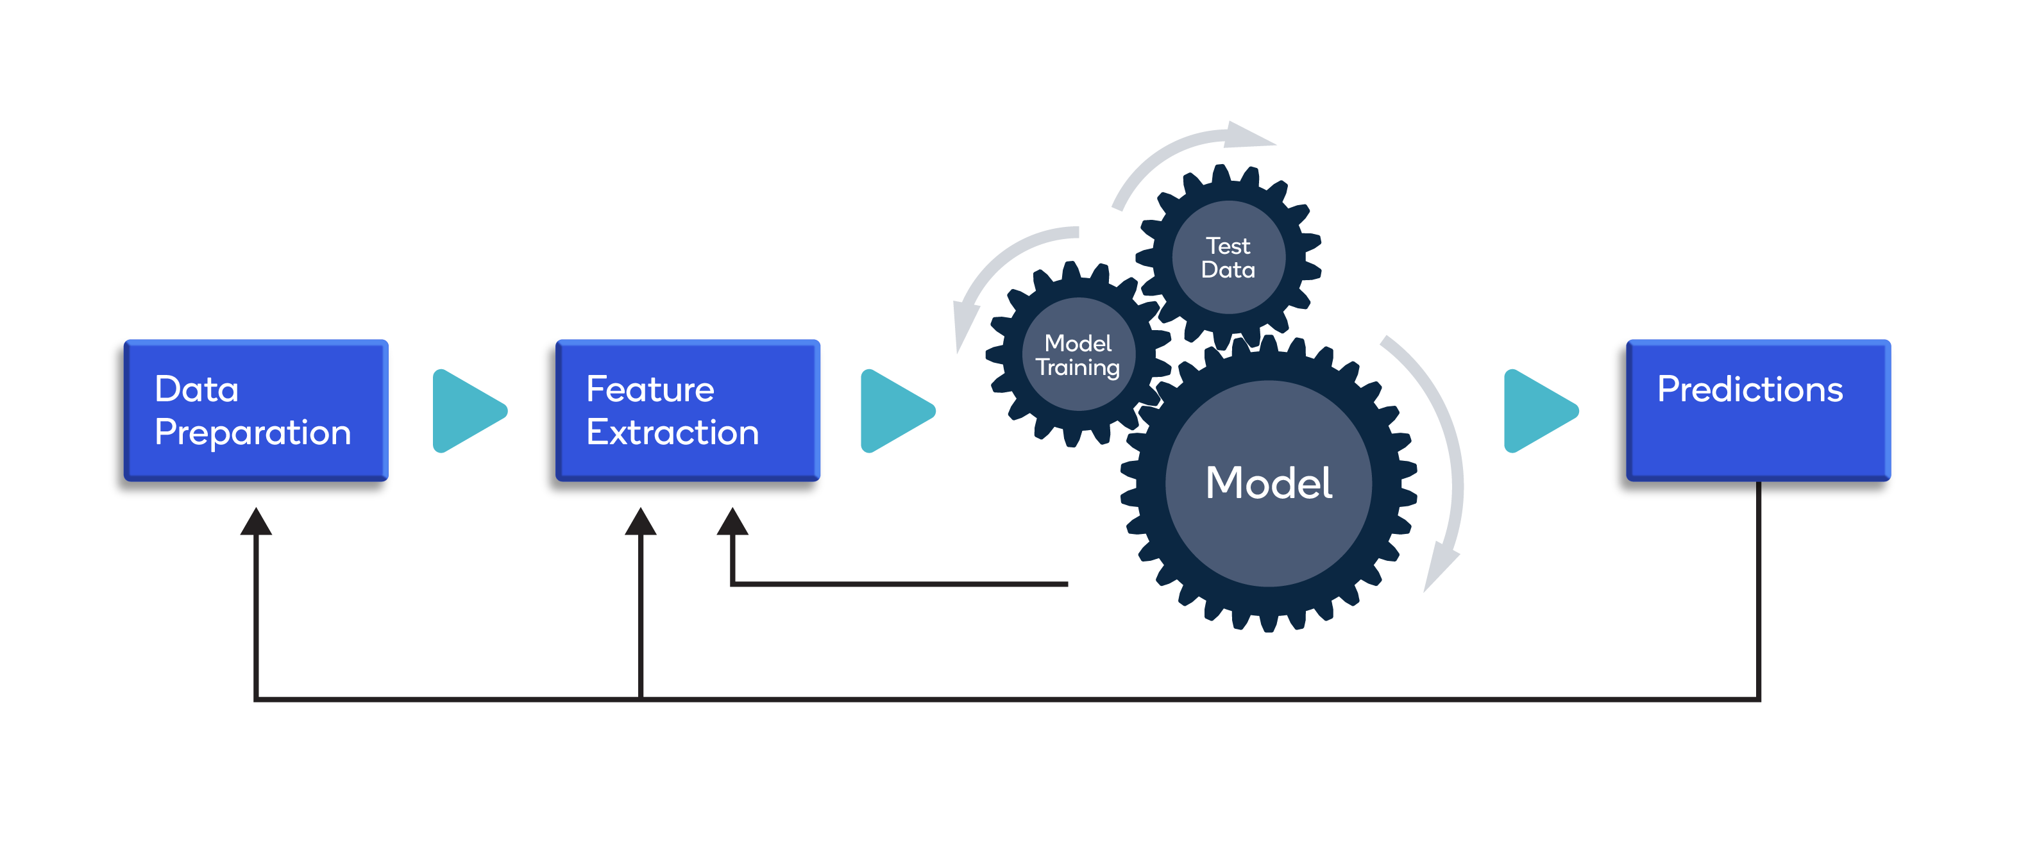
Modeling
5. Model Evaluation:
Evaluate model using accuracy, precision, recall, and F1 score. Analyze confusion matrix for error identification.
6. Optimization Techniques:
Apply data augmentation for increased training data diversity.Explore transfer learning and model ensembling.
7. Deployment and Integration:
Deploy model for real-time classification.Develop user-friendly interface or API for integration.
8. Continuous Monitoring:
Monitor model performance in production.Gather user feedback for continuous improvement.

Slide 15

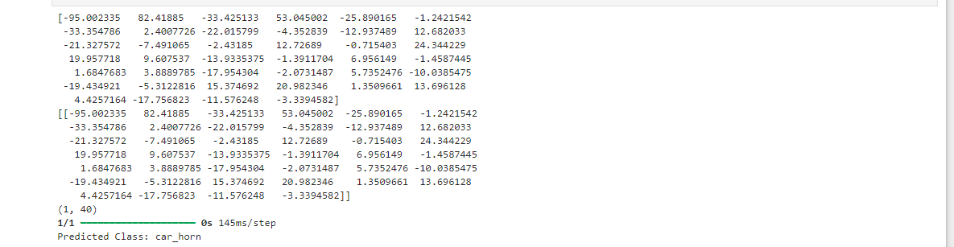
RESULT
Test accuracy:
Prediction:

Slide 16
Thank You

